Slide 1

SWOT Analysis
Strengths
Weaknesses
Opportunities
Threats

Slide 2
What is swot analysis
SWOT analysis is a method for identifying and analyzing internal strengths and weaknesses and external opportunities and threats that shape current and future operations and help develop strategic goals.
It is designed to facilitate a realistic, fact-based, data-driven look at the strengths and weaknesses of an organization, initiatives, or within its industry
Using internal and external data, the technique can guide businesses toward strategies more likely to be successful, and away from those in which they have been, or are likely to be, less successful.

Slide 3
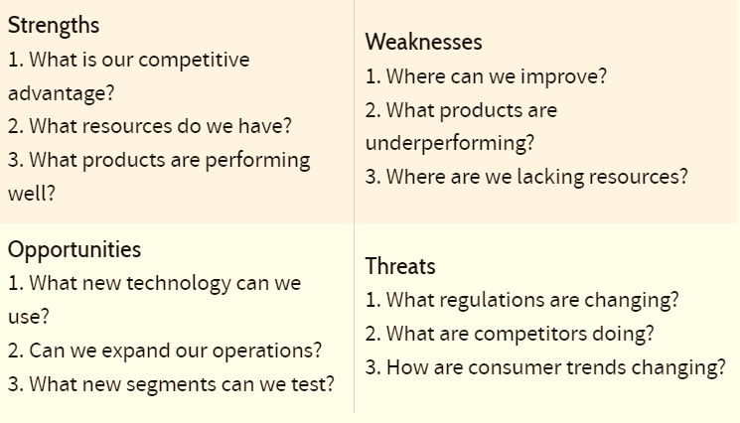

Slide 4
How to implement swot analysis
Step 1: Determine your objective
A SWOT analysis can be broad, though more value will likely be generated if the analysis is pointed directly at an objective. For example, the objective of a SWOT analysis may focused only on whether or not to perform a new product rollout.
Step 2: Gather Resources
Every SWOT analysis will vary, and a company may need different data sets to support pulling together different SWOT analysis tables. A company should begin by understanding what information it has access to, what data limitations it faces, and how reliable its external data sources are.

Slide 5
Step 3: Compile Ideas
For each of the four components of the SWOT analysis, the group of people assigned to performing the analysis should begin listing ideas within each category.
Step 4: Refine Findings
With the list of ideas within each category, it is now time to clean-up the ideas. By refining the thoughts that everyone had, a company can focus on only the best ideas or largest risks to the company.

Slide 6
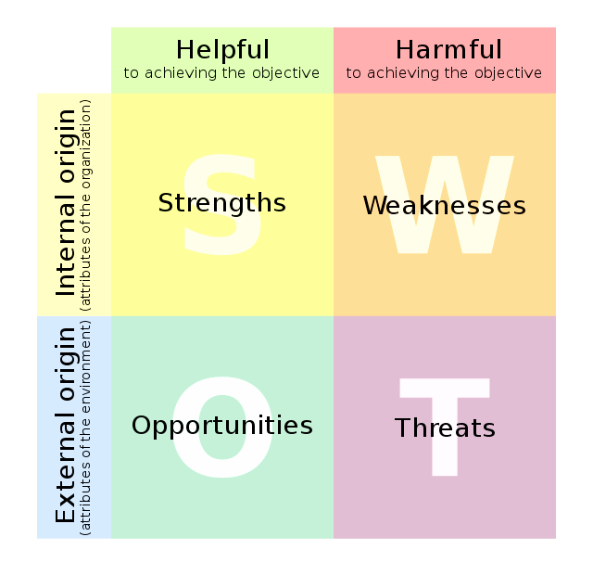
Step 5: Develop the Strategy
Armed with the ranked list of strengths, weaknesses, opportunities, and threats, it is time to convert the SWOT analysis into a strategic plan. Members of the analysis team take the bulleted list of items within each category and create a synthesized plan that provides guidance on the original objective.

Slide 7
Benefits of swot analysis
A SWOT analysis makes complex problems more manageable.
A SWOT analysis requires external consider.
A SWOT analysis can be applied to almost every business question.
A SWOT analysis leverages different data sources.
A SWOT analysis may not be overly costly to prepare.

Slide 8
THANK
YOU
By-
Abhinav Paidisetti
N. Shanmukha Sai

